Slide 1

Computers Principles
5Lecture/ Introduction of Computers
Civil Engineering Department
College of Engineering / Diyala University/ 2015-2016.
Dr. Qasim Adnan Aljanabi

Slide 2
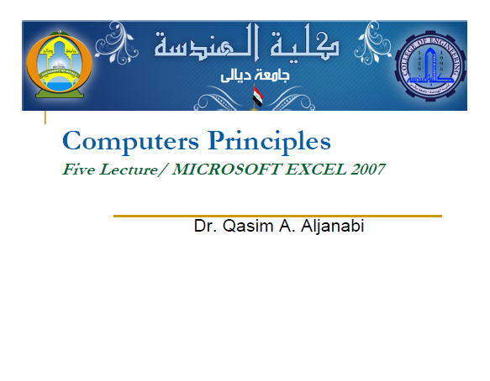

Slide 3
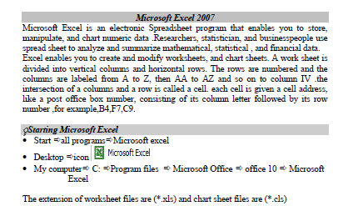

Slide 4
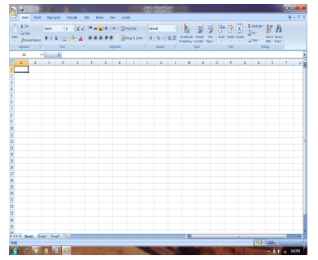

Slide 5
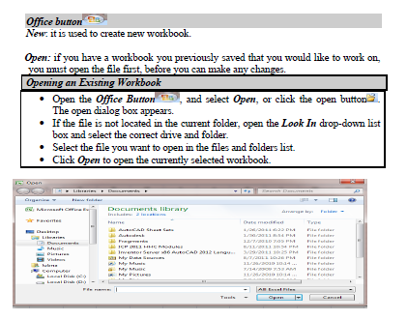

Slide 6
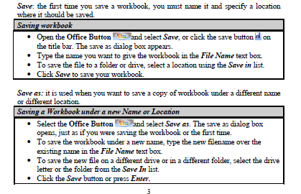

Slide 7
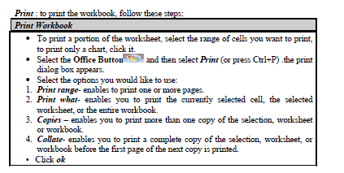

Slide 8
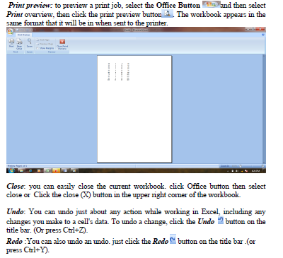

Slide 9
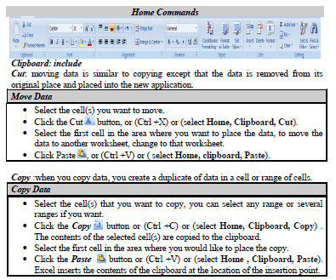

Slide 10

Questions - ?

